Slide 1
License Plate Detection
Matt Morais
CSC
11/3/2022

Slide 2
Overview
Background / Goals
Methodology
Results
Conclusions / Further Work

Slide 3
Background / Goals
Background
Utility of License Plate Detection
Motivation
Simple case of object detection
Use more complex forms of this at work, want to understand more
Goals
Find a license plate in a simple scene
Find letters / numbers on license plate
Convert image to text
Overlay bounding boxes and display text interpretation
Develop custom OCR (simple)

Slide 4
Methodology

Slide 5
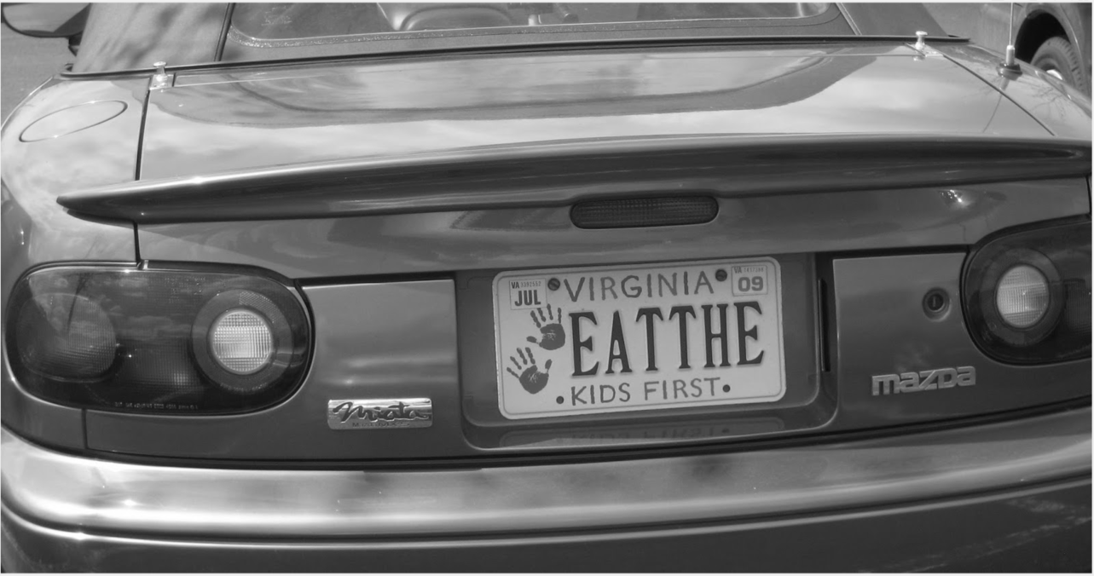
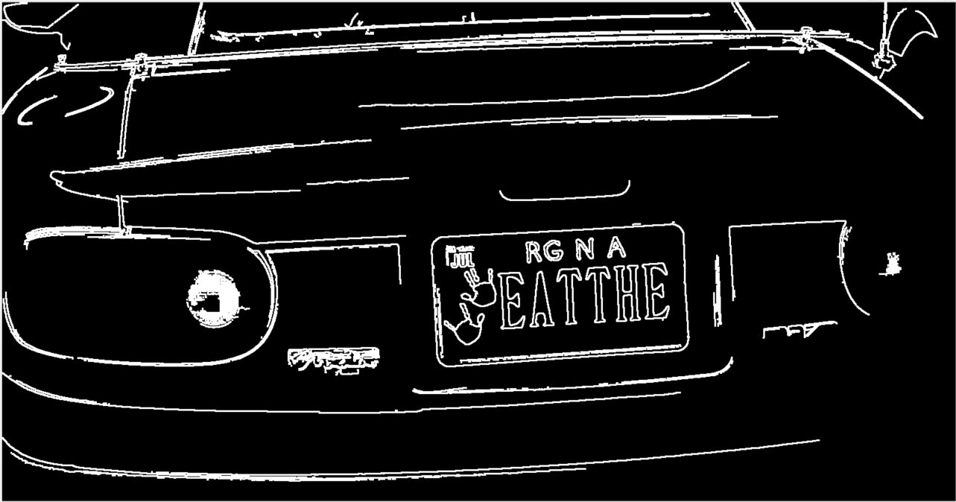
Edge Detection
Used Sobel Edge Detection to get edges
Dilated image to increase thickness of lines

Slide 6
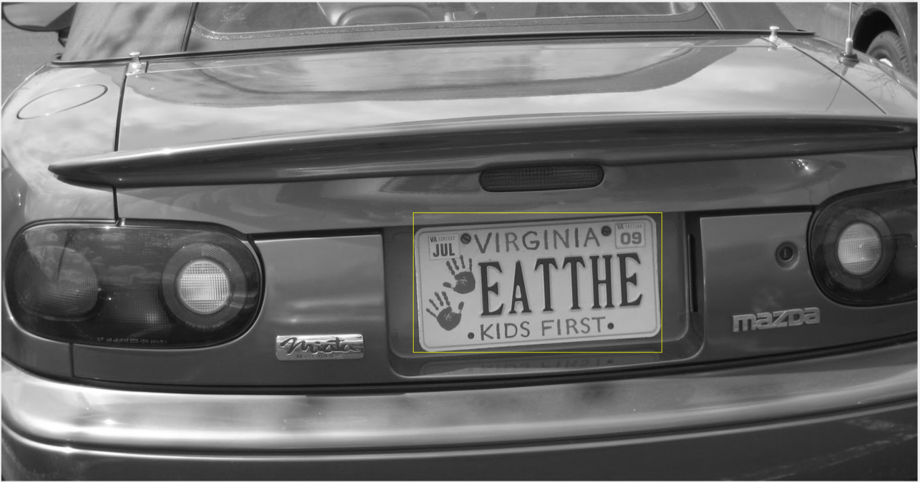
Plate Blob Detect
Used aspect Ratio of blob
Also used area, to reduce chance of selecting small blob
This ended up being a problem
Limited scope

Slide 7
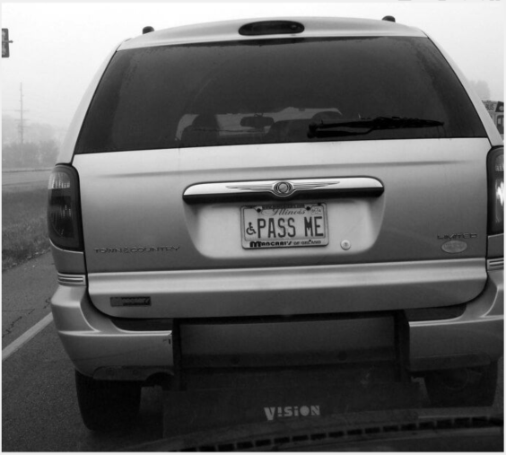
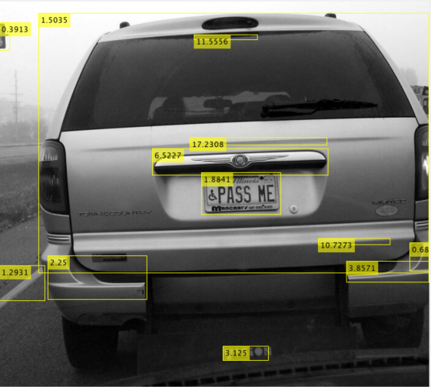
Plate Blob Detect
Issues with aspect ratio for plate detection
Could not figure out a solution
Tried segmenting with color channels
Ended up having to tune search params
Not a viable Real-Time solution

Slide 8
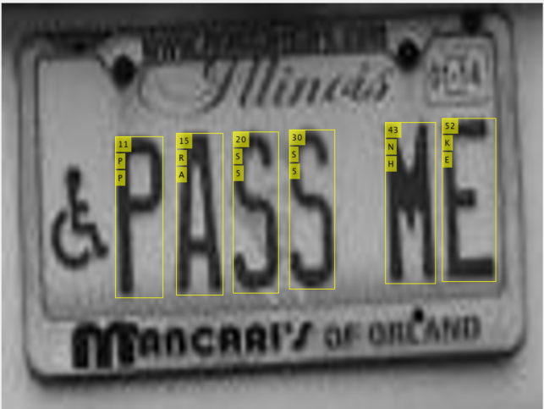
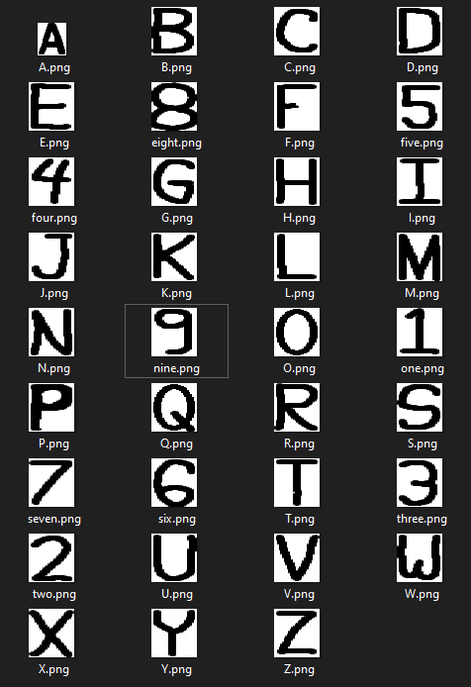
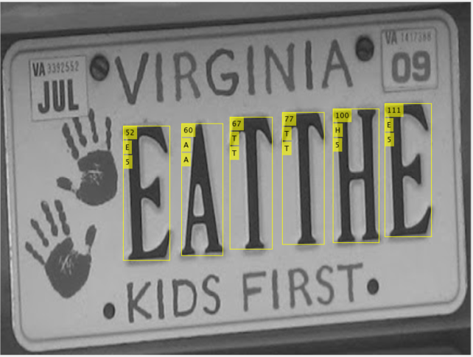
Letter Recognition
Segment image of license plate to get individual letters
Number is Blob ID
First letter is Matlab OCR, second is my technique

Slide 9
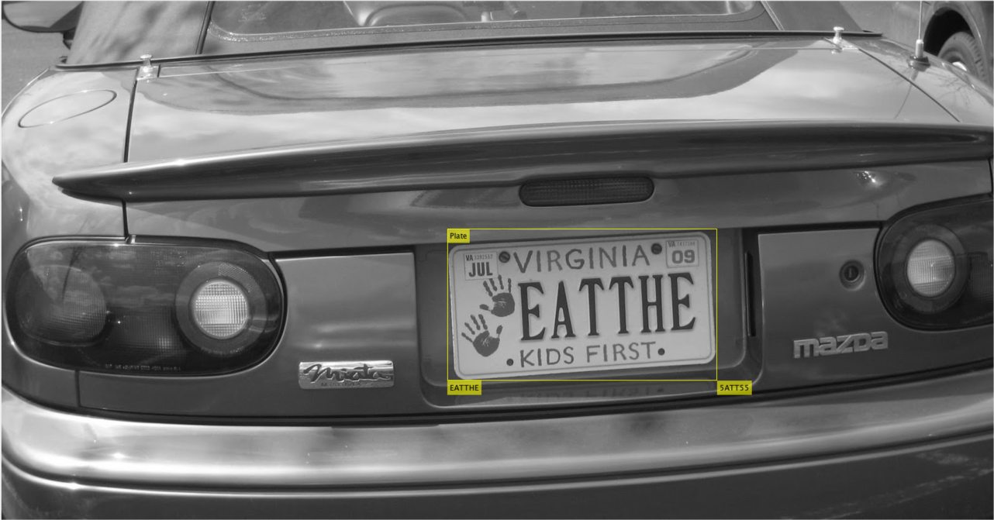
End Result

Slide 10
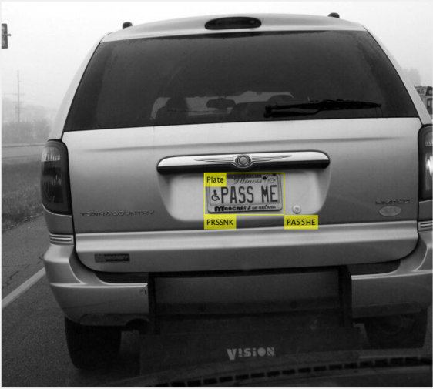
End Result

Slide 11
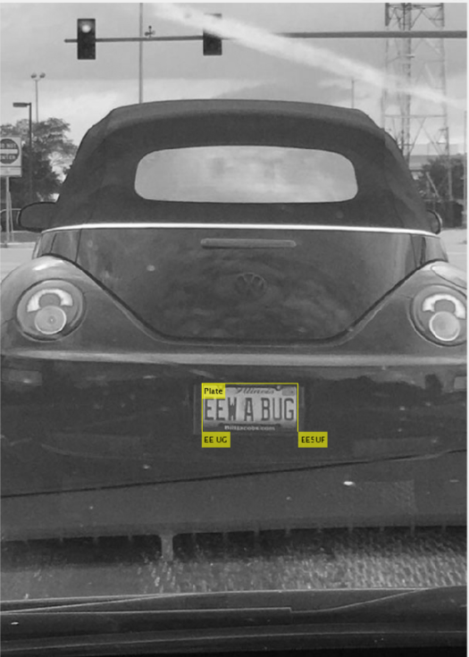
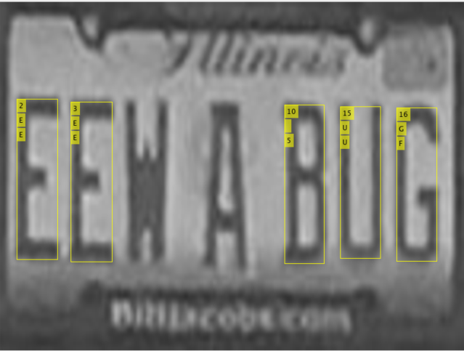
End Result

Slide 12
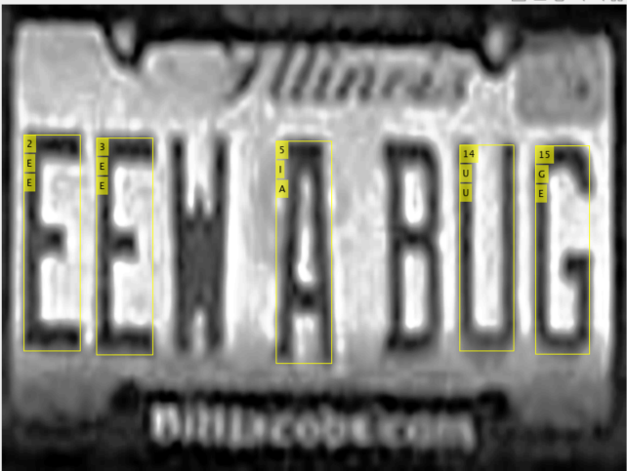
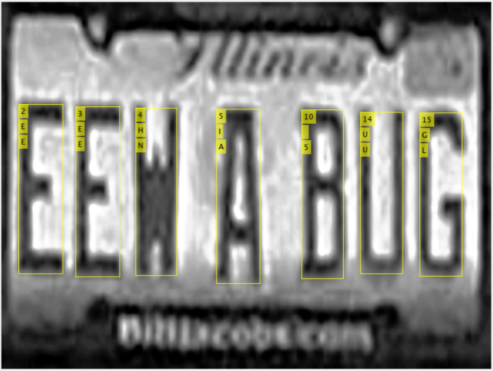
Results / Discussion
Finding the Plate is possible, with some tweaking
Overall OCR was not very accurate
I tried histogram equalization on the plates, and that helped, but OCR still couldn’t recognize the shapes
I also tried running another edge detect on the plate itself, and running a erode to make the letters thinner – still no luck.
Image | Plate Found? | Actual Plate | Matlab OCR | My OCR
1 | Yes | EAT THE | EATTHE | 5ATT55
2 | Yes | PASS ME | PRSSNK | PA55HE
3 | Yes | EEW A BUG | EE UG | EE5UF

Slide 13
Future Works
Need to develop a more dynamic plate detection algorithm
More robust than aspect ratio
Perhaps better way of segmenting image
Detection of letters locations worked well
Need to better compare an image of a character to a computer character
Maybe include more than just one style for my own OCR

